Slide 1
MA3077 (DLI) Operational Research Lecture 7 – Mixed-integer linear problems
Dr Marco Fasondini

Slide 2
Recapitulation and lecture outline
Summary: so far we learnt:
how to model linear programming problems and solve them in Matlab,
how to analyse them using Farkas' lemma,
the role (and interpretation) of weak and strong duality and sensitivity analysis.
Today: A first glimpse into mixed-integer programming following loosely Ch. 3 of OptArt and Ch. 9 of the book by Hillier and Lieberman.

Slide 3
A&E unit – problem statement
Scenario: Evening shift doctors in the A&E department of a hospital work five consecutive days and have two consecutive days off.
Their five days of work can start on any day of the week and the schedule rotates indefinitely.
The hospital requires the following minimum number of doctors working each day:
Finally, no more than 35 doctors can start their five working days on the same day.
Question: Find a rota to minimise the number of A&E doctors employed.
Mon | Tue | Wed | Thu | Fri | Sat | Sun
45 | 50 | 61 | 40 | 60 | 50 | 26

Slide 4
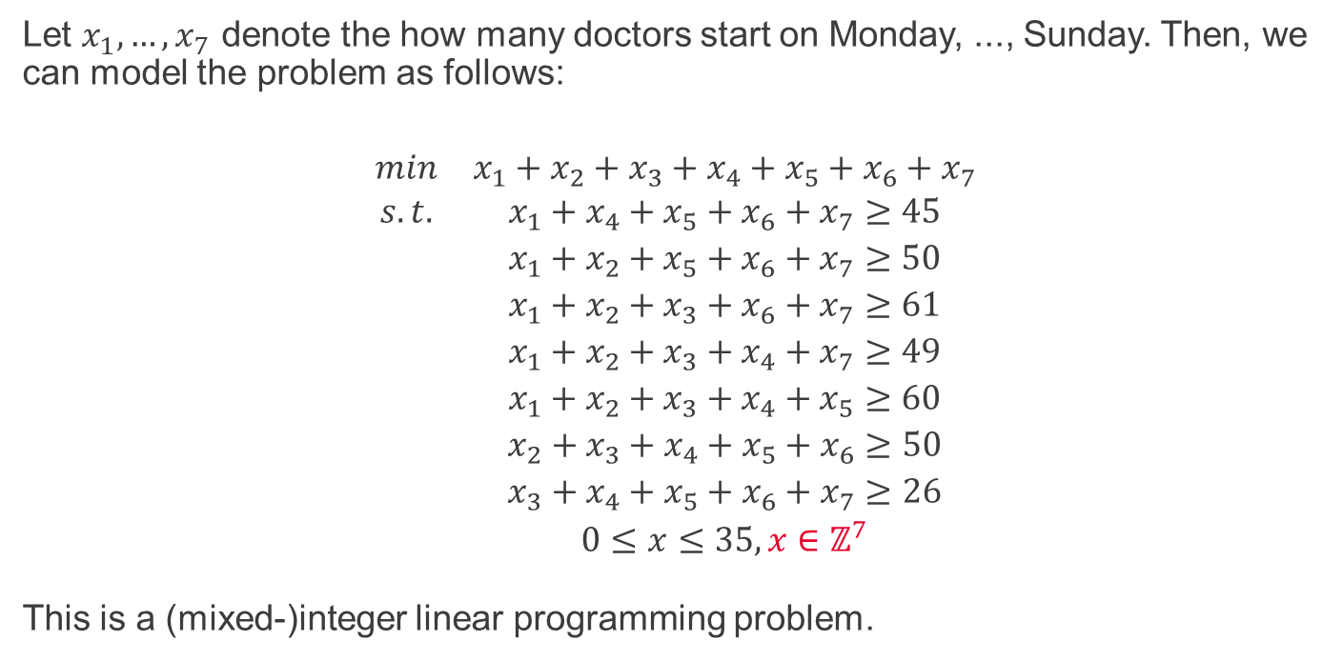
A&E unit – mathematical model
Let $x_{1},…,x_{7}$ denote the how many doctors start on Monday, ..., Sunday. Then, we can model the problem as follows:
$$\begin{matrix}min & x_{1}+{x_{2}+x_{3}+x}_{4}+x_{5}+x_{6}+x_{7} \\ s.t. & x_{1}{+ x}_{4}+ x_{5}+x_{6}+x_{7}≥45 \\ & x_{1}+{x_{2}+x}_{5}+x_{6}+x_{7}≥50 \\ & x_{1}+{x_{2}+x_{3}+x}_{6}+x_{7}≥61 \\ & x_{1}+{x_{2}+x_{3}+x}_{4}+x_{7}≥49 \\ & x_{1}+{x_{2}+x_{3}+x}_{4}+x_{5}≥60 \\ & {x_{2}+x_{3}+x}_{4}+x_{5}+x_{6}≥50 \\ & x_{3}+x_{4}+x_{5}+x_{6}+x_{7}≥26 \\ & 0≤x≤35, x∈ℤ^{7}\end{matrix}$$
This is a (mixed-)integer linear programming problem.

Slide 5
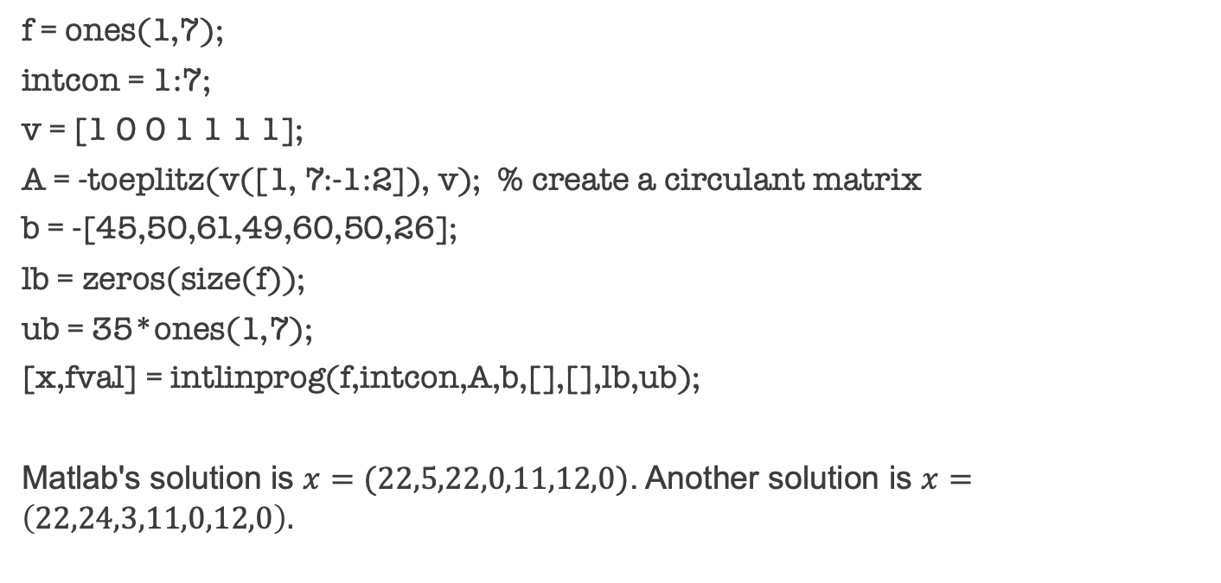
Solving this example in Matlab with intlinprog (see OR7_intlinprog.m)
f = ones(1,7);
intcon = 1:7;
v = [1 0 0 1 1 1 1];
A = -toeplitz(v([1, 7:-1:2]), v); % create a circulant matrix
b = -[45,50,61,49,60,50,26];
lb = zeros(size(f));
ub = 35*ones(1,7);
[x,fval] = intlinprog(f,intcon,A,b,[],[],lb,ub);
Matlab's solution is $x=(22,5,22,0,11,12,0)$. Another solution is $x=\left(22,24,3,11,0,12,0\right).$

Slide 6
Mixed-integer optimisation problems are difficult
More precisely, they are NP hard, meaning that we can verify that a solution is correct in polynomial time, and we do not know whether we can solve them with a deterministic algorithm in polynomial time (however, if you find out how to do it, you will become very rich and famous).
The beautiful duality theory we developed for linear programming problems does not apply.
In many practical cases, an exact solution cannot be found in reasonable time.
To find out what Matlab's intlinprog does, see this documentation page.

Slide 7
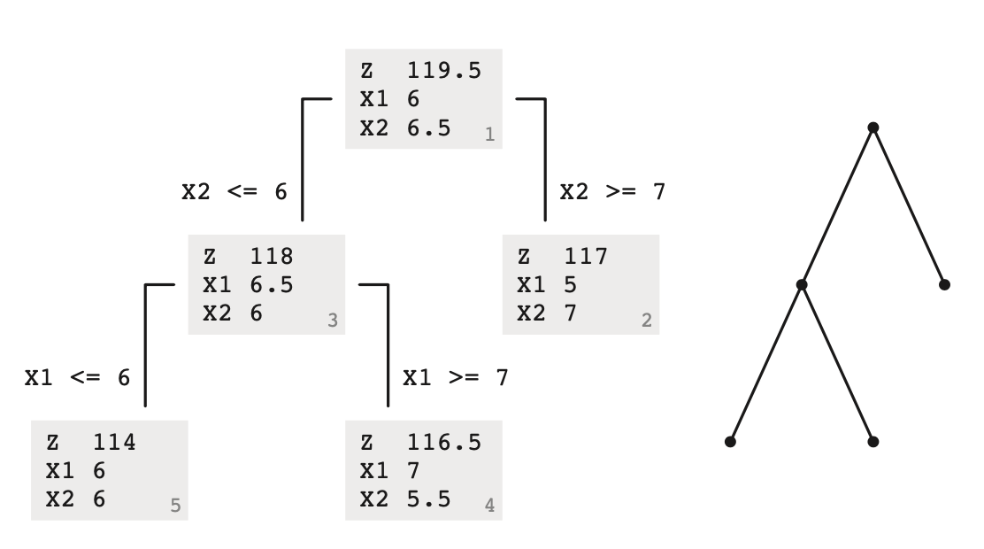
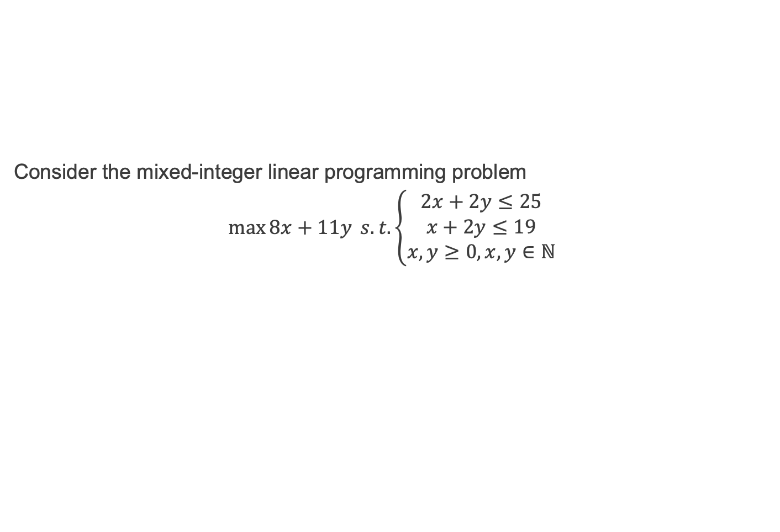
The branch and bound method (see OR7_branch_and_bound.m)
Consider the mixed-integer linear programming problem
$$\max{8x+11y} s. t. \left\{\begin{aligned}2x+2y≤25 \\ x+2y≤19 \\ x,y≥0, x,y∈ℕ\end{aligned}\right.$$

Slide 8
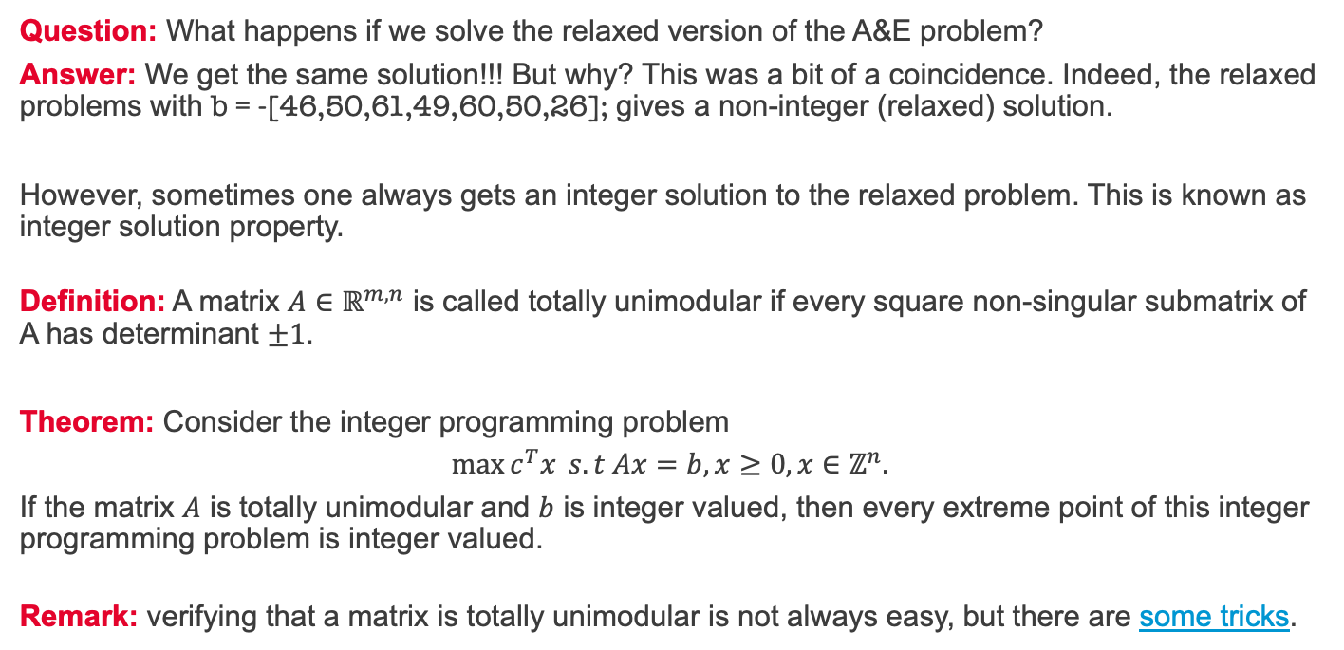
Branch and bounding the A&E unit problem
Question: What happens if we solve the relaxed version of the A&E problem?
Answer: We get the same solution!!! But why? This was a bit of a coincidence. Indeed, the relaxed problems with b = -[46,50,61,49,60,50,26]; gives a non-integer (relaxed) solution.
However, sometimes one always gets an integer solution to the relaxed problem. This is known as integer solution property.
Definition: A matrix $A∈ℝ^{m,n}$ is called totally unimodular if every square non-singular submatrix of A has determinant $±1$.
Theorem: Consider the integer programming problem
$$\max{c^{T}x} s.t Ax=b, x≥0, x∈ℤ^{n}.$$
If the matrix $A$ is totally unimodular and $b$ is integer valued, then every extreme point of this integer programming problem is integer valued.
Remark: verifying that a matrix is totally unimodular is not always easy, but there are some tricks.

Slide 9
Example with integer solution property
Transportation problem: you employ two artisans who produce chairs and you have three customers who need chairs. Artisan 1 produced 10 chairs and artisan 2 produced 20 chairs. Customer 1 needs 6 chairs, customer 2 needs 8 chairs, and customer 3 needs 16 chairs. The cost to ship a chair from each artisan to any of the three customers is summarised in the following table:
Question: To whom should artisans 1 and 2 ship their chairs to minimise the shipping costs for your company?
 | Customer 1 | Customer 2 | Customer 3
Artisan 1 | £14 | £11 | £12
Artisan 2 | £10 | £12 | £18

Slide 10
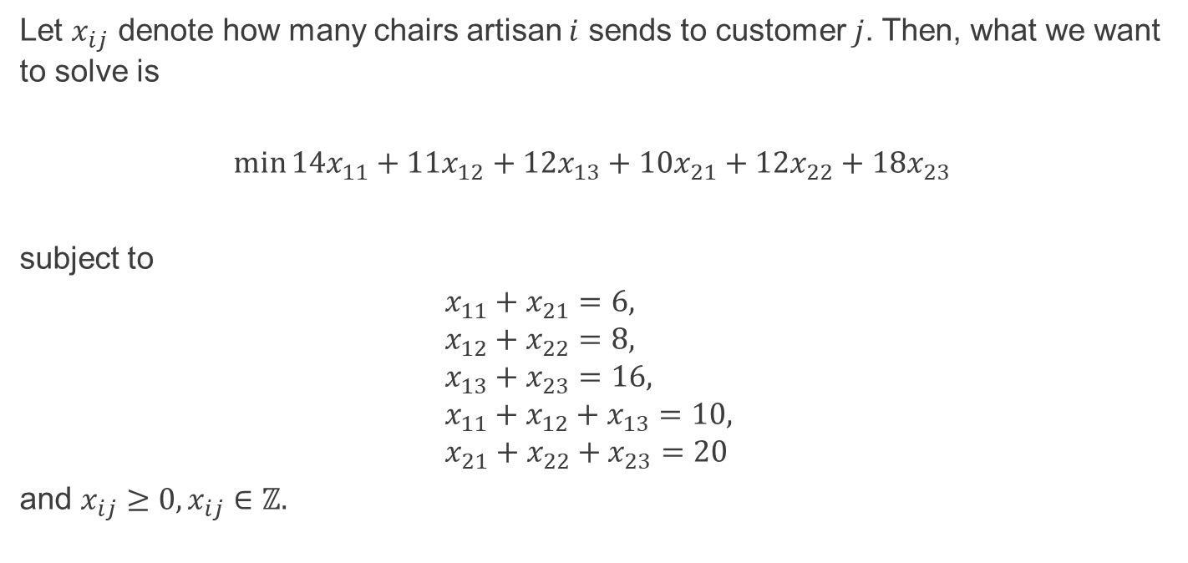
Transportation problem - model
Let $x_{ij}$ denote how many chairs artisan $i$ sends to customer $j$. Then, what we want to solve is
$$\min{14x_{11}+11x_{12}+12x_{13}+10x_{21}+12x_{22}+18x_{23}}$$
subject to
$$x_{11}+x_{21}=6, \\ x_{12}+x_{22}=8, \\ x_{13}+x_{23}=16, \\ x_{11}+x_{12}+x_{13}=10, \\ x_{21}+x_{22}+x_{23}=20$$
and $x_{ij}≥0,x_{ij}∈ℤ.$

Slide 11
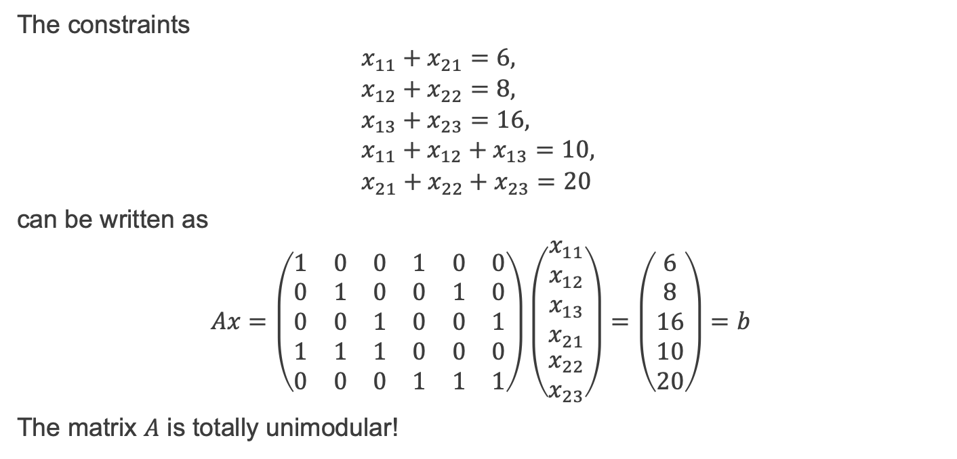
Transportation problem – totally unimodular
The constraints
$$x_{11}+x_{21}=6, \\ x_{12}+x_{22}=8, \\ x_{13}+x_{23}=16, \\ x_{11}+x_{12}+x_{13}=10, \\ x_{21}+x_{22}+x_{23}=20$$
can be written as
$$Ax=\left(\begin{matrix}1 & 0 & 0 & 1 & 0 & 0 \\ 0 & 1 & 0 & 0 & 1 & 0 \\ 0 & 0 & 1 & 0 & 0 & 1 \\ 1 & 1 & 1 & 0 & 0 & 0 \\ 0 & 0 & 0 & 1 & 1 & 1\end{matrix}\right)\left(\begin{matrix}x_{11} \\ x_{12} \\ x_{13} \\ x_{21} \\ \begin{aligned}x_{22} \\ x_{23}\end{aligned}\end{matrix}\right)=\left(\begin{matrix}6 \\ 8 \\ 16 \\ 10 \\ 20\end{matrix}\right)=b$$
The matrix $A$ is totally unimodular!

Slide 12
Summary and self-study
Summary: today we have learnt
how to model some mixed-integer linear programming problems,
how to solve them in Matlab using intlinprog,
and what the branch and bound technique is.
Self-study: Formulate the following problem as mixed-integer linear programming problem.
Scenario: A colleague of mine convenes the module MA3513 Industrial Mathematics Project. In this module, students work in groups for one year on a project set by an industrial partner. This summer my colleague collected 7 potential projects and now he must allocate students to projects. This year there are 32 students and he would like to let them choose what project they'd like to work on. To this end, he asked them to rank their top-three preferred projects.
Question: How should he allocate students to projects to maximise their happiness while at the same time ensuring that no project has fewer than 4 or more than 5 students?

